Slide 1
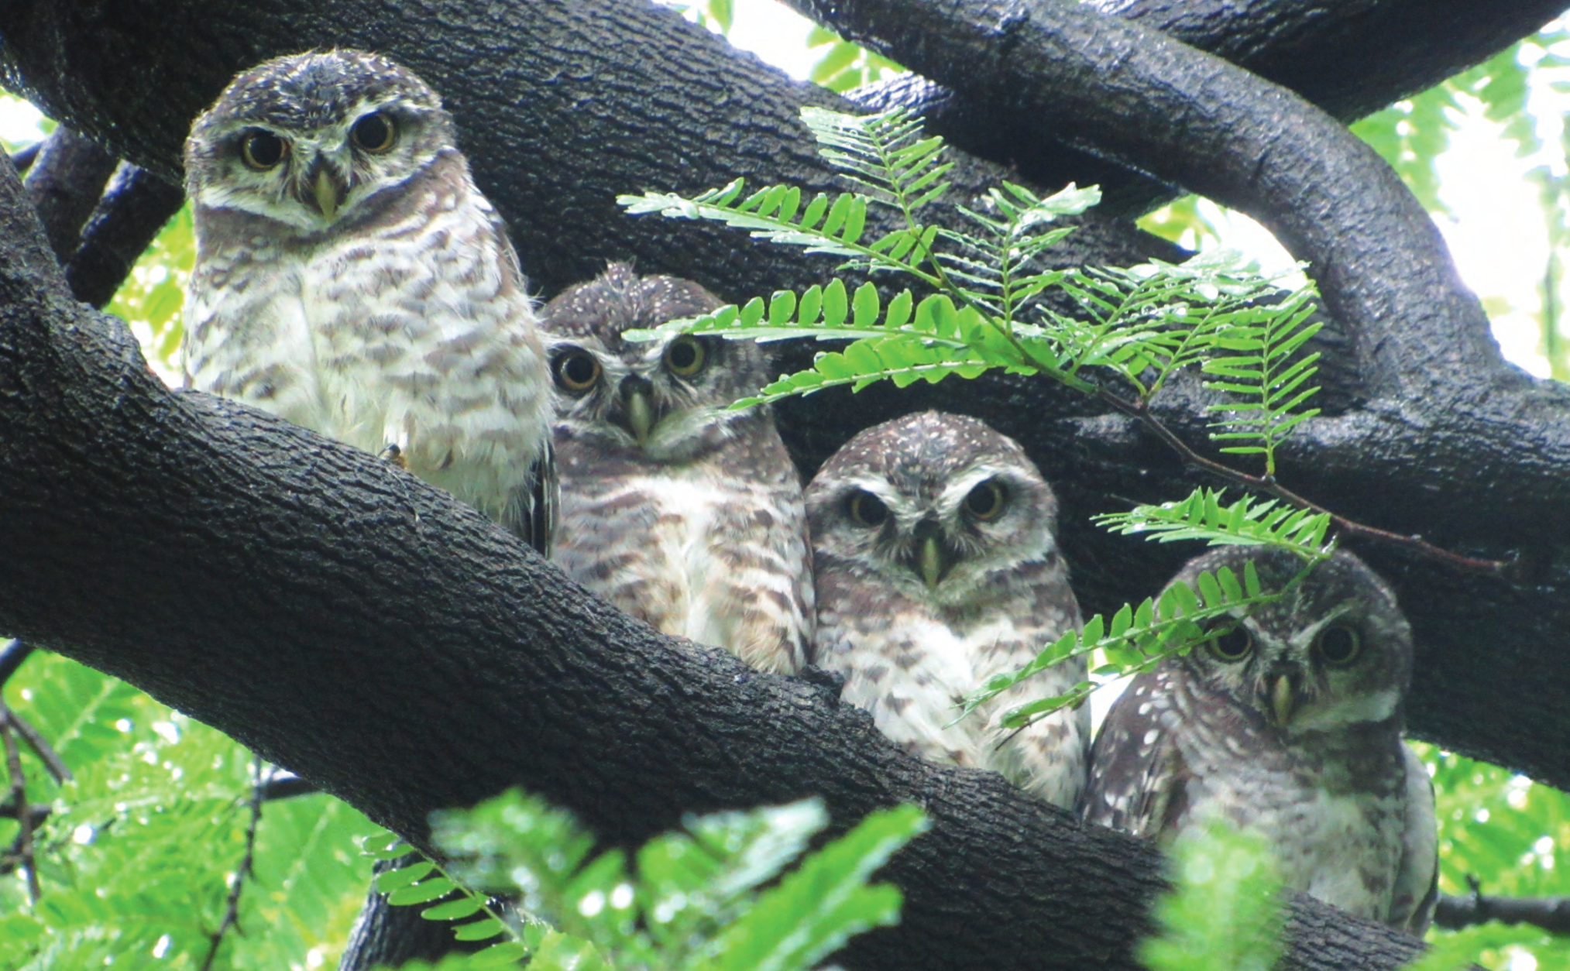
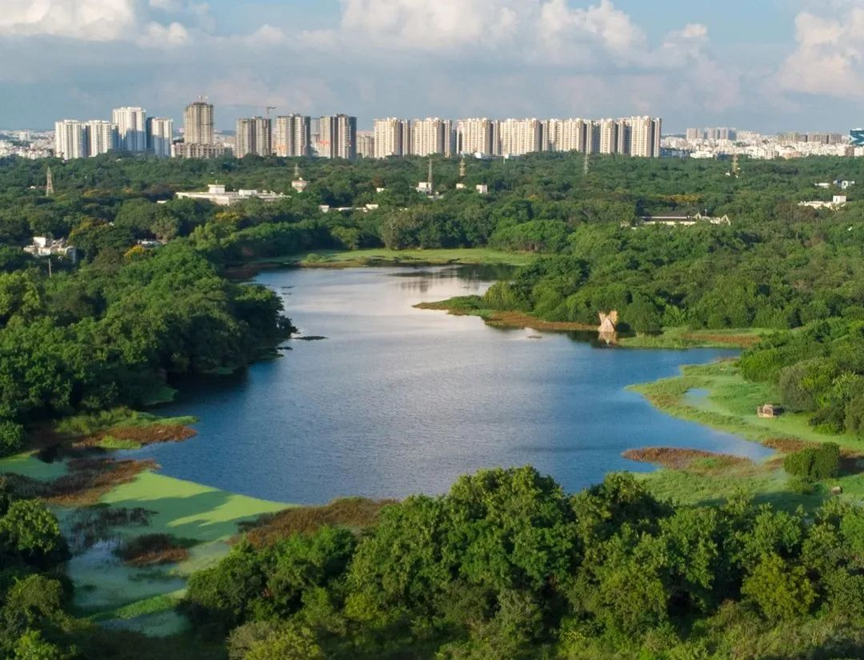
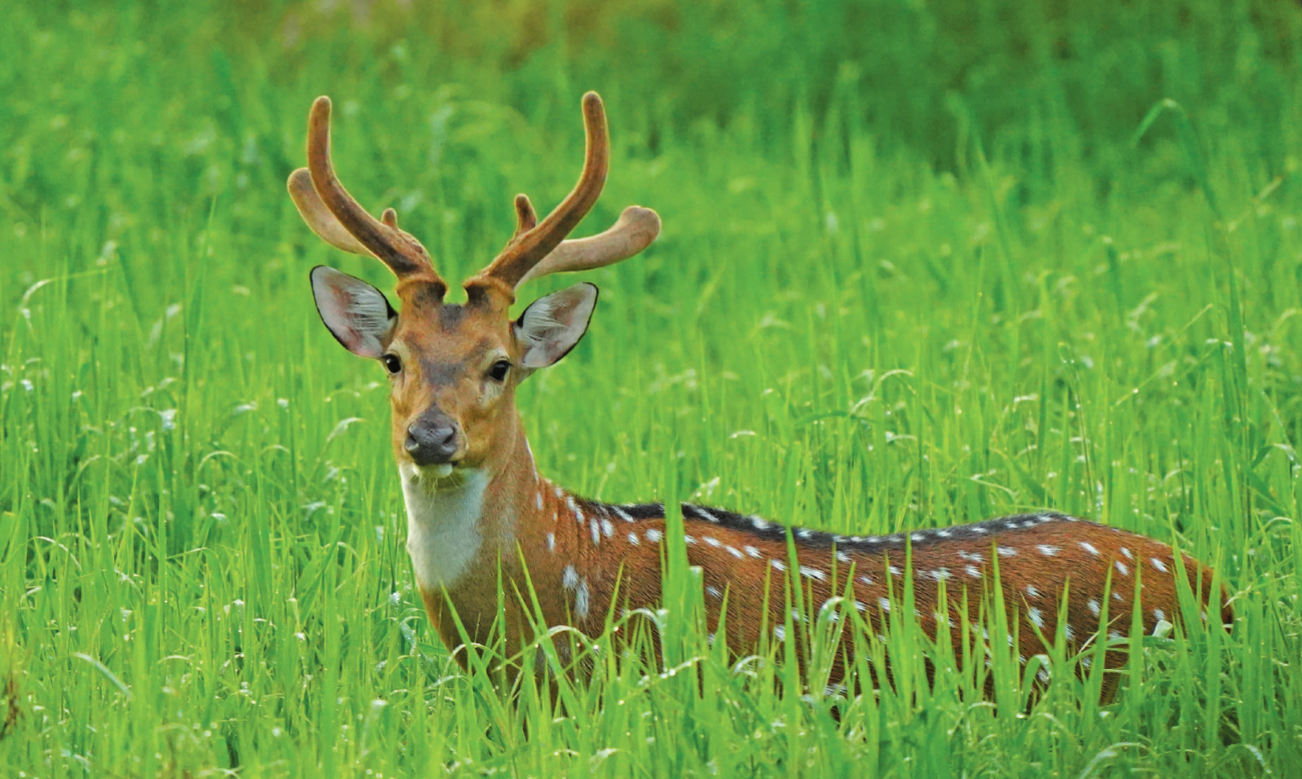


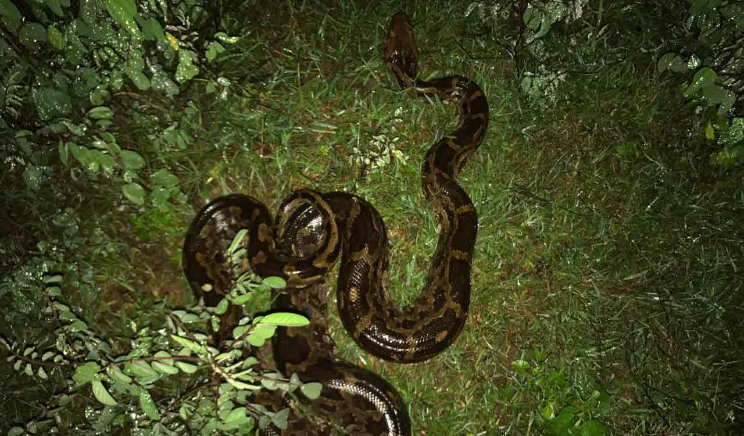
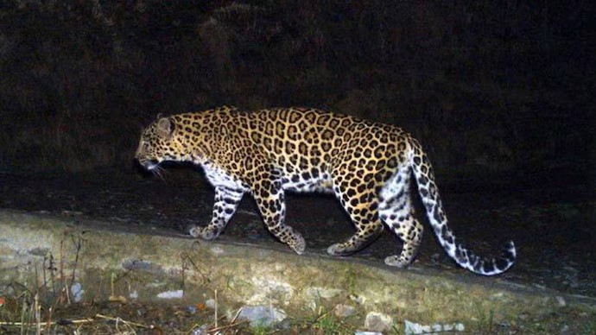
HSF-India HEP Software Workshop at the University of Hyderabad GPU programming
Session 3
Brij Kishor Jashal
Rutherford Appleton Lab, UK

Slide 2
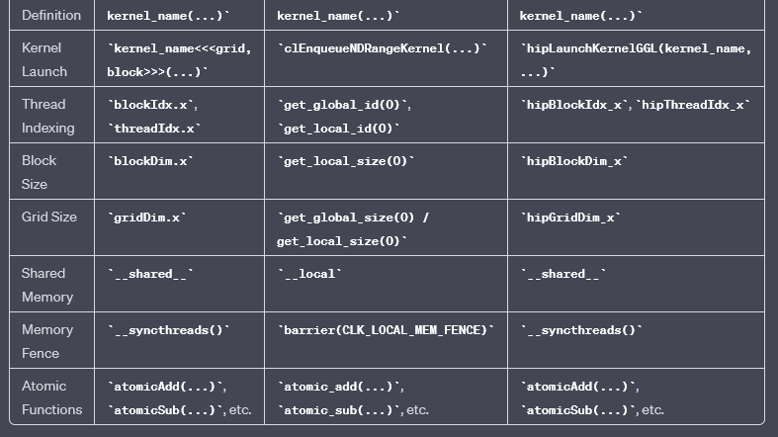
GPGPU languages: Concepts are same, terminologies are different
Language | Cuda | OpenAcc | HIP

Slide 3
Modern software project stack example
Executables (build)
GNU Make
Python configuration (sequences, selection lines )
CMake
Performance portability layer
(Backend header only files, BackendCommon.h, CPUID.h, CUDABackend.h, HIPBackend.h)
Compilers (GCC, CLANG, CudaClang, HIPClang, NVCC, HIPCC)
Base algorithms (C / C++, SYCL, CUDA, HIP )
External base libraries:
{ CUDA libraries, ROCm, HIP, boost-devel, zeromq-devel, zlib-devel, GSL or gls-lite, catch2 umesimd, ROOT, Python3 with (wrapt, cachetools, pydot, sympy)}

Slide 4
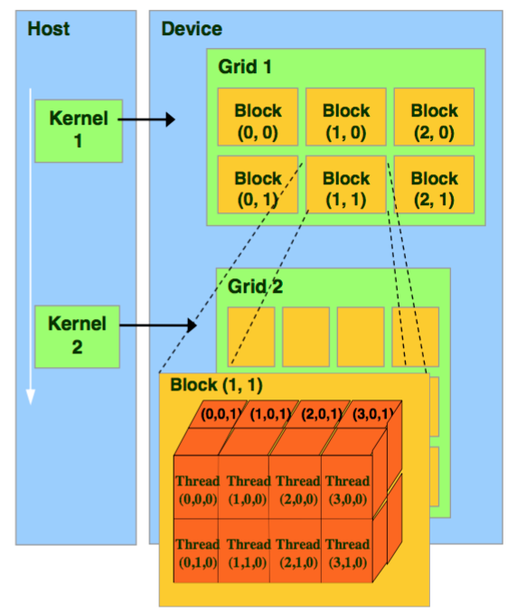
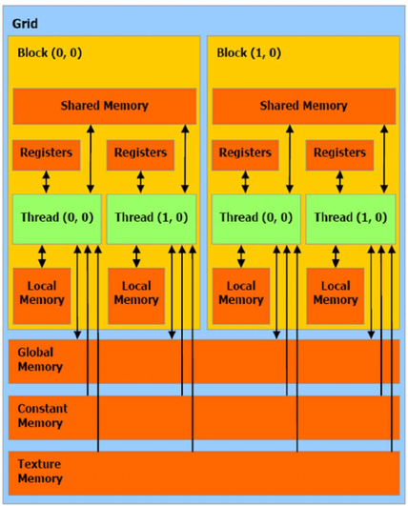
Outline

Slide 5
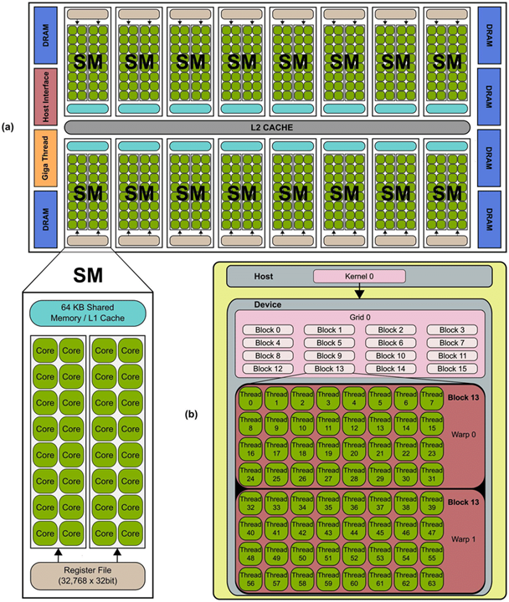
Outline

Slide 6
Outline
1. Thread execution
2. Memory system
3. Memory Access
1.Tiling
2.Coalescing

Slide 7
Thread Execution

Slide 8
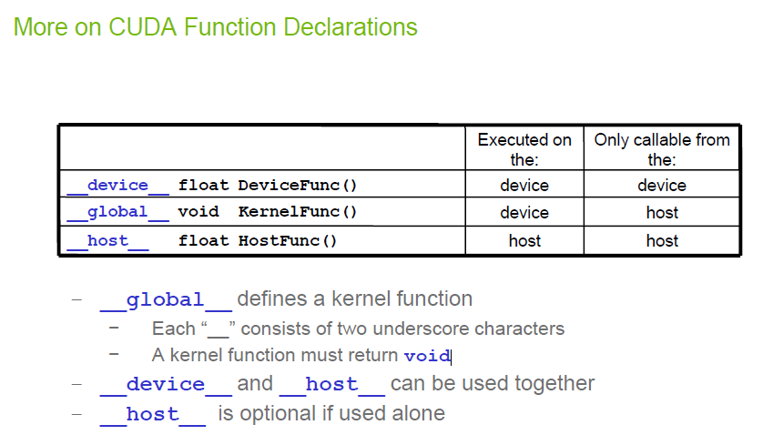
Function declaration

Slide 9
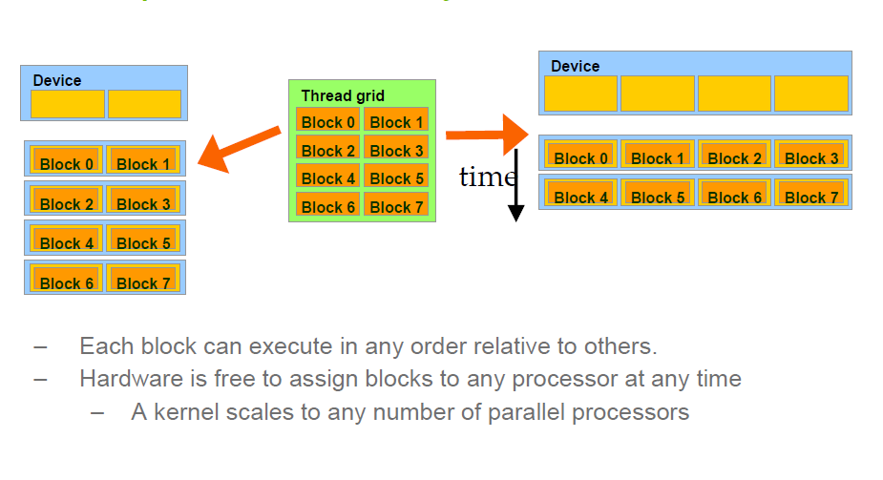
Transparent Scalability

Slide 10
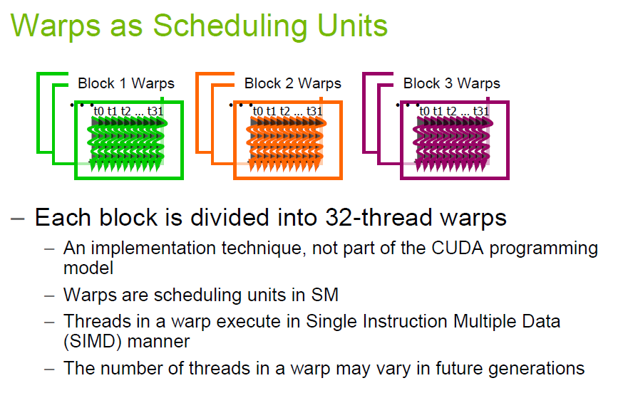
48 in some latest GPUs

Slide 11
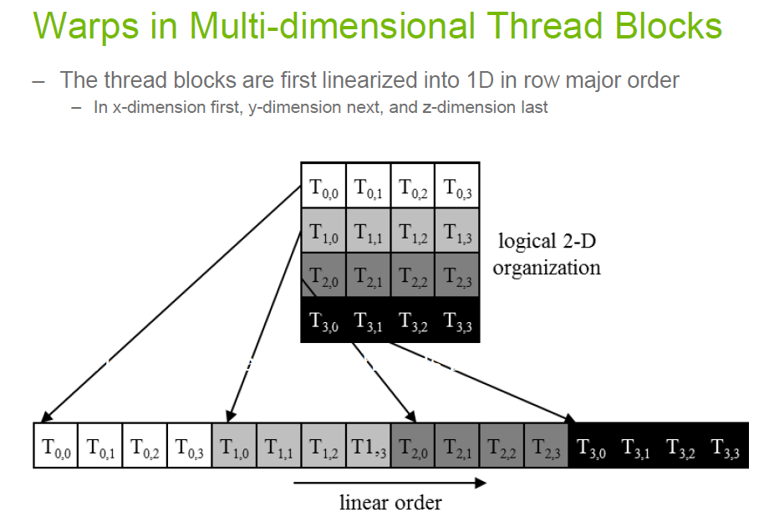

Slide 12
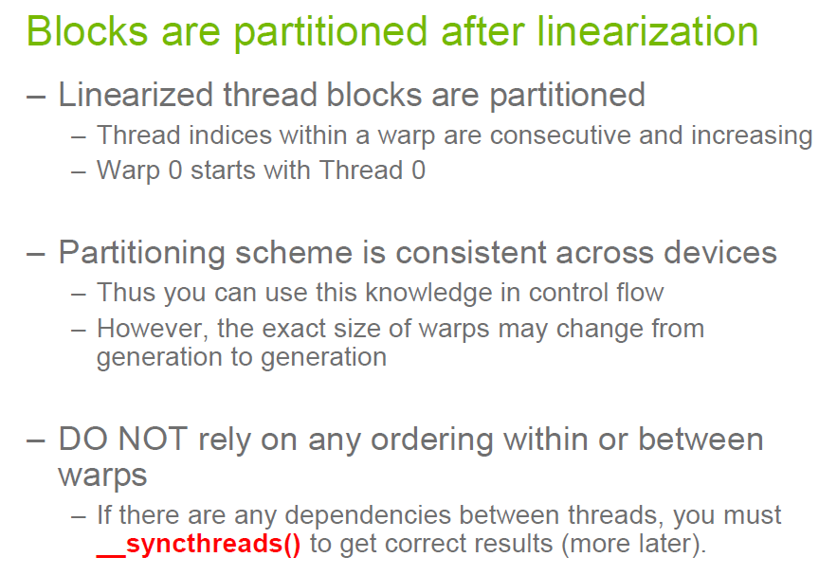

Slide 13
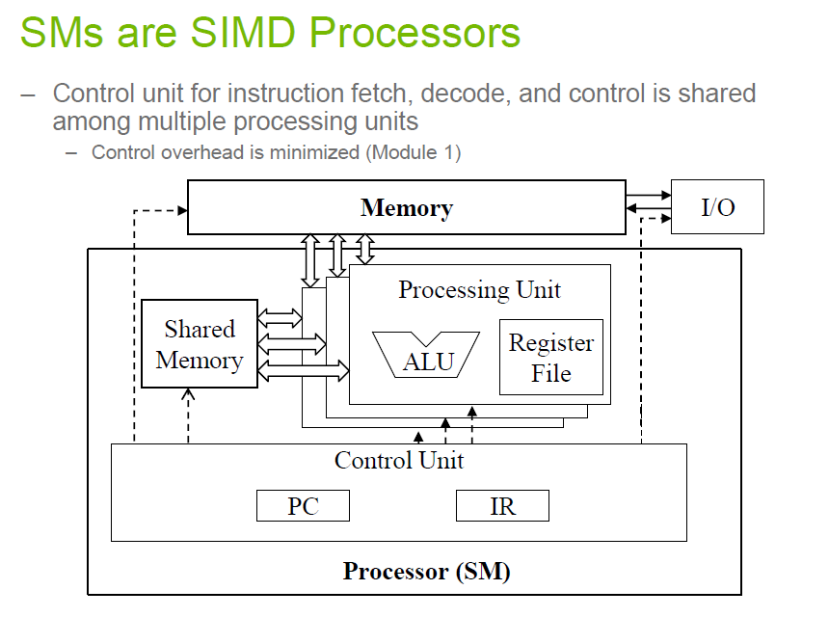

Slide 14
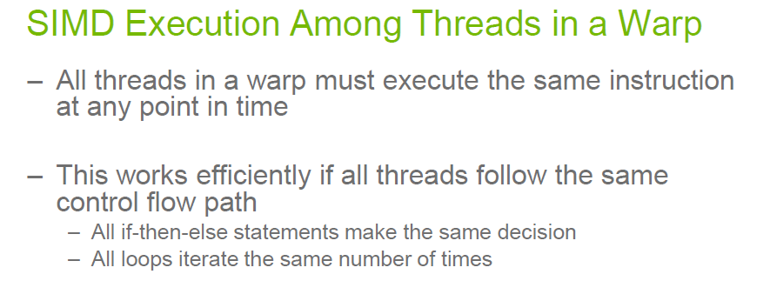

Slide 15
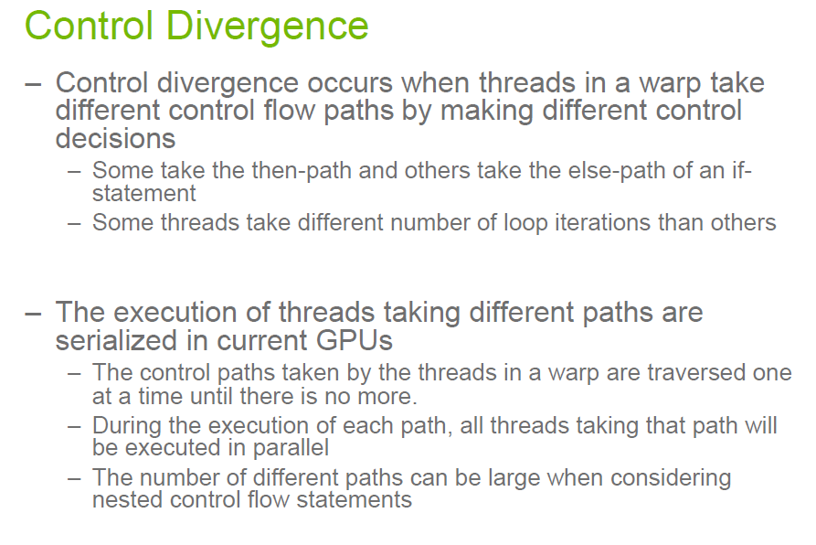

Slide 16
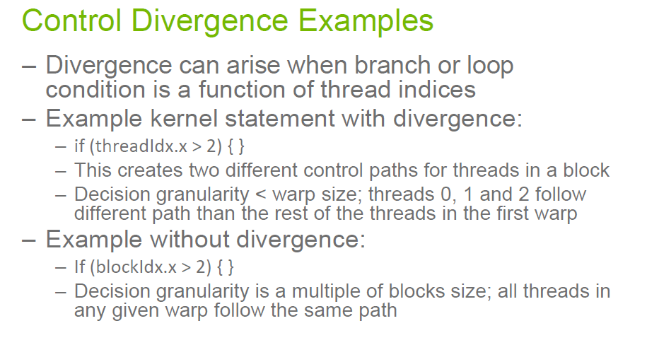

Slide 17
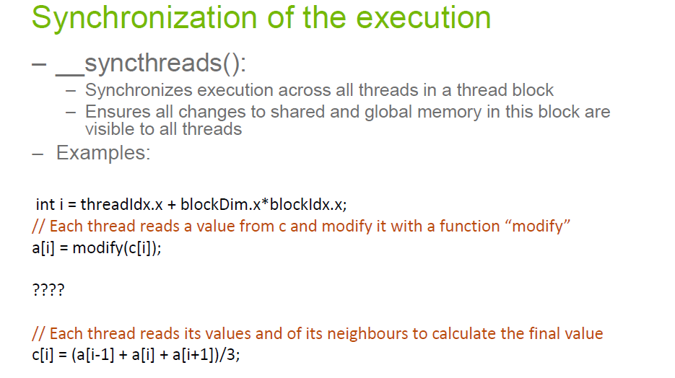

Slide 18
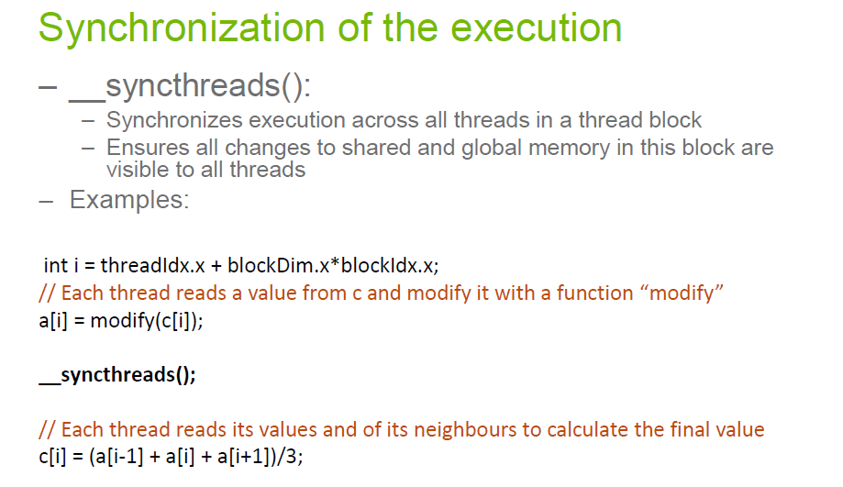

Slide 19
MEMORY SYSTEM

Slide 20
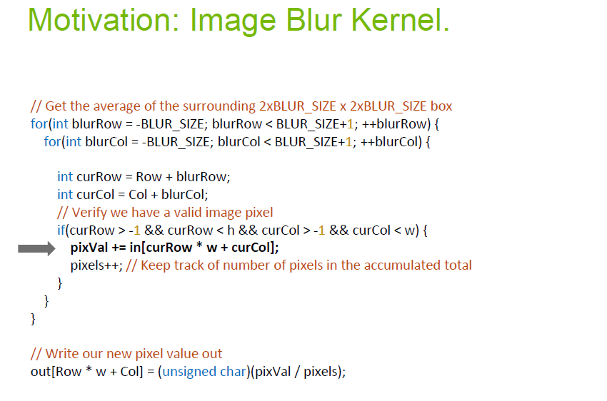

Slide 21
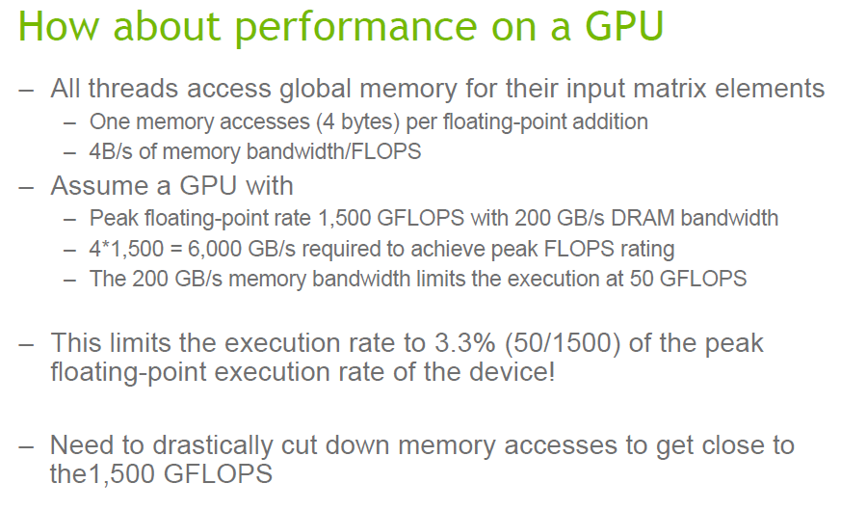

Slide 22
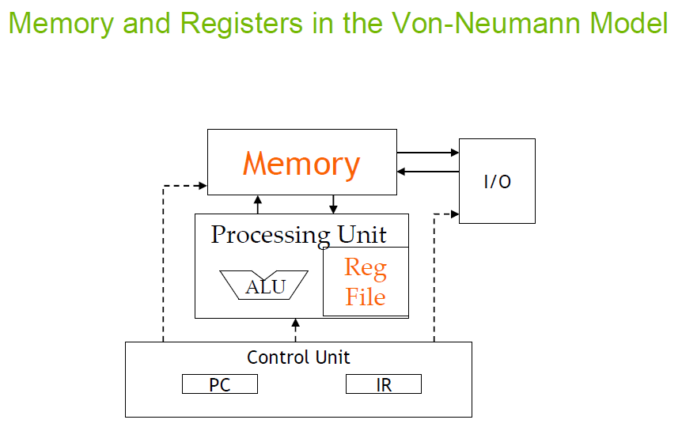

Slide 23
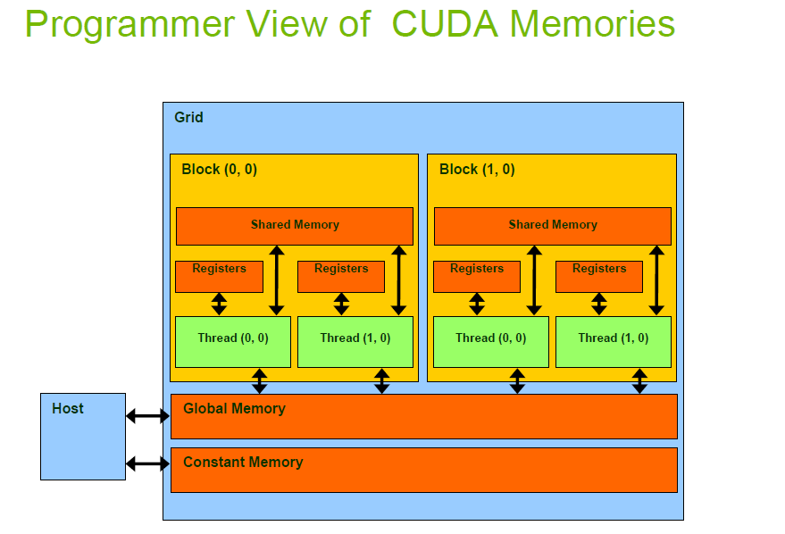

Slide 24
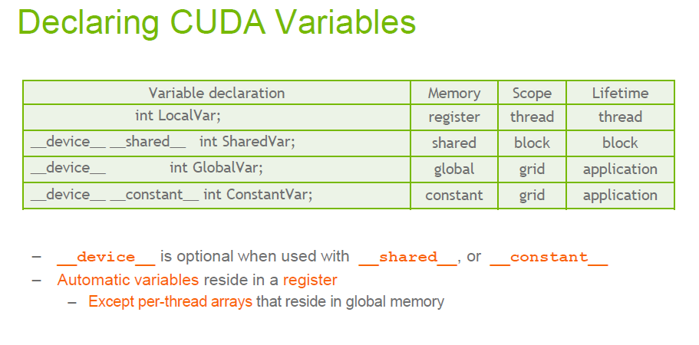

Slide 25
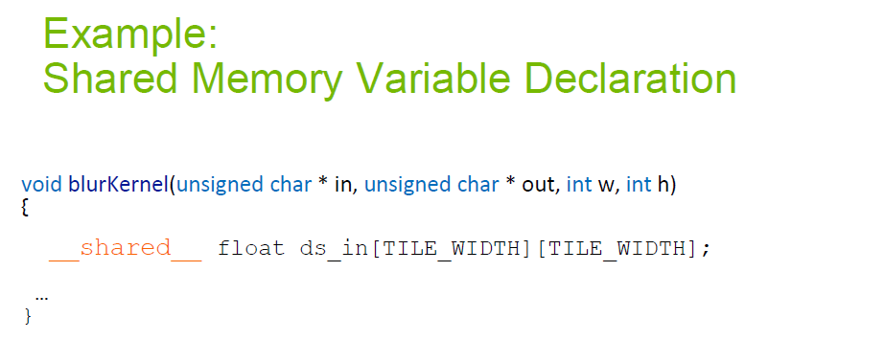

Slide 26
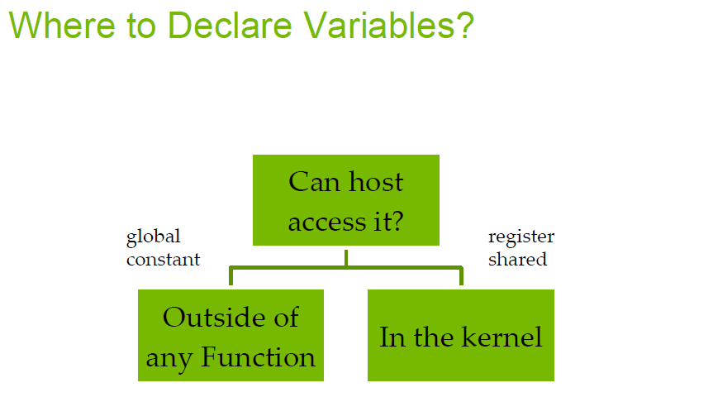

Slide 27
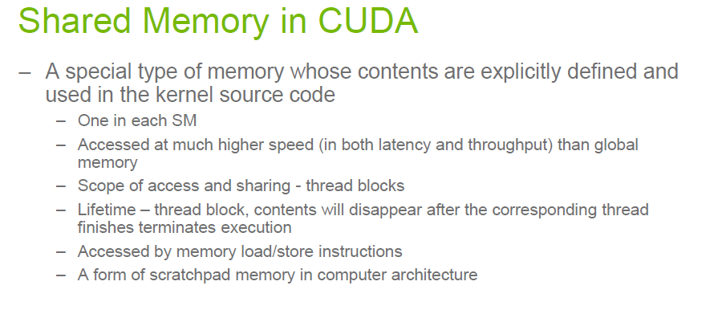

Slide 28
MEMORY ACCESS

Slide 29
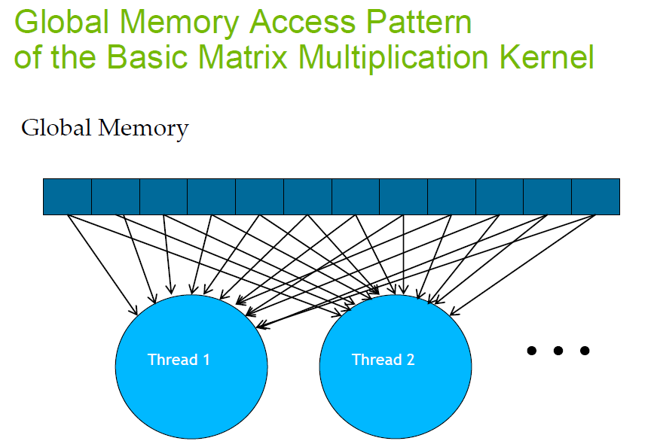

Slide 30
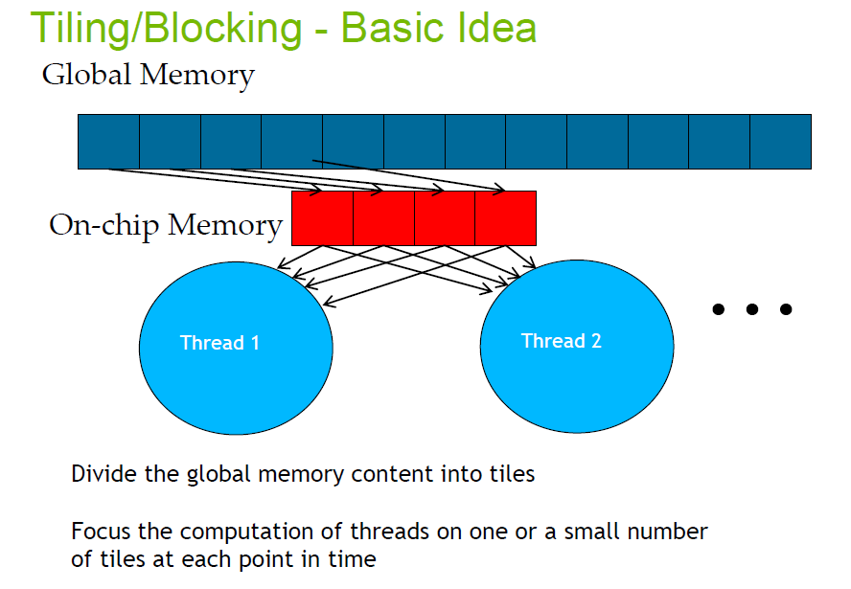

Slide 31
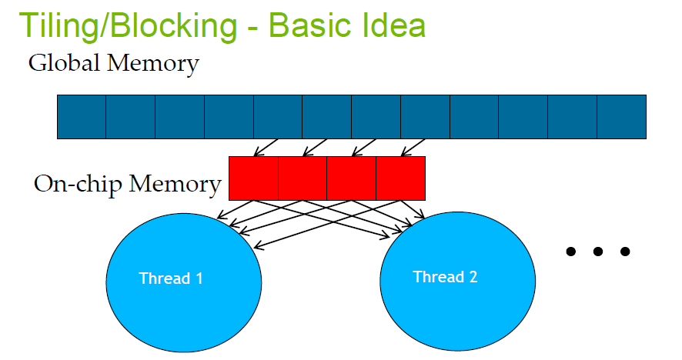

Slide 32
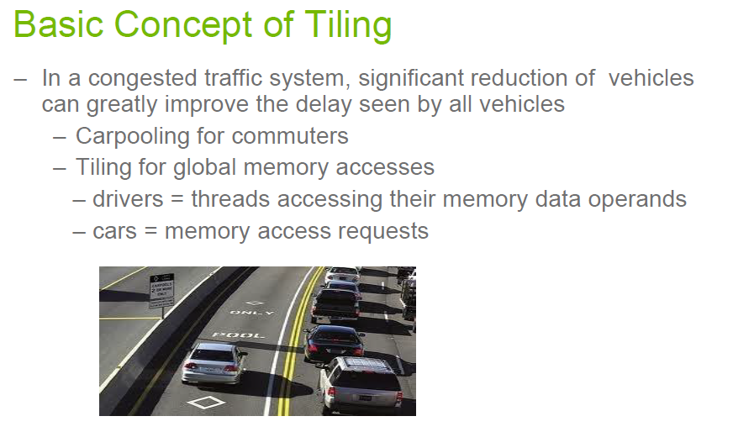

Slide 33
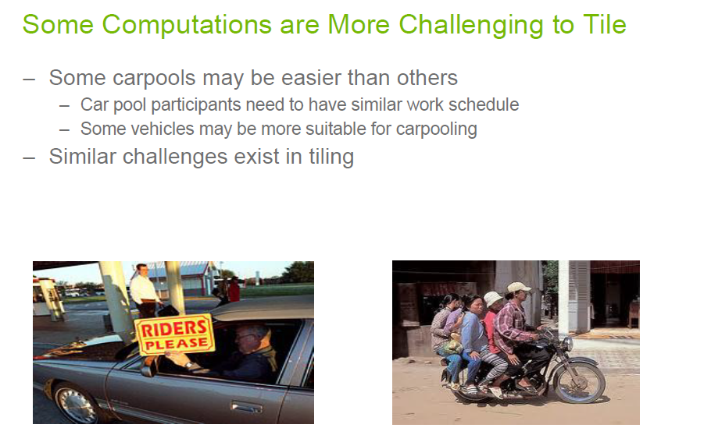

Slide 34
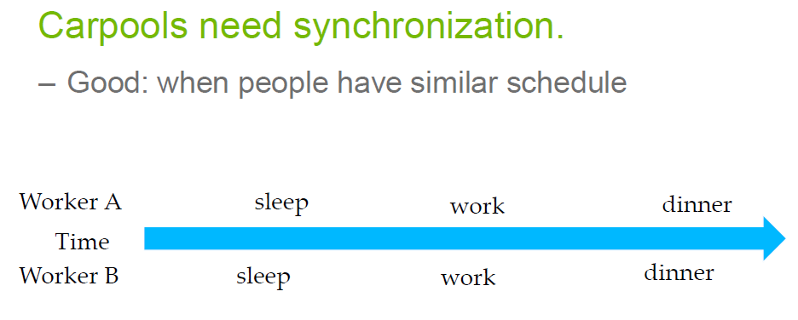

Slide 35
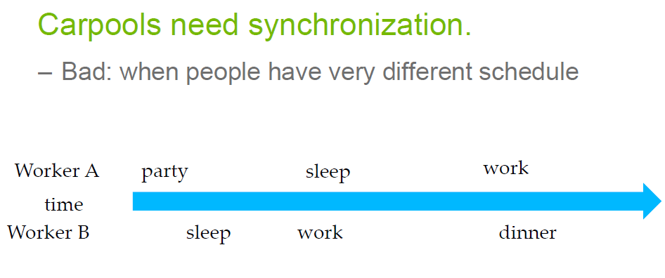

Slide 36
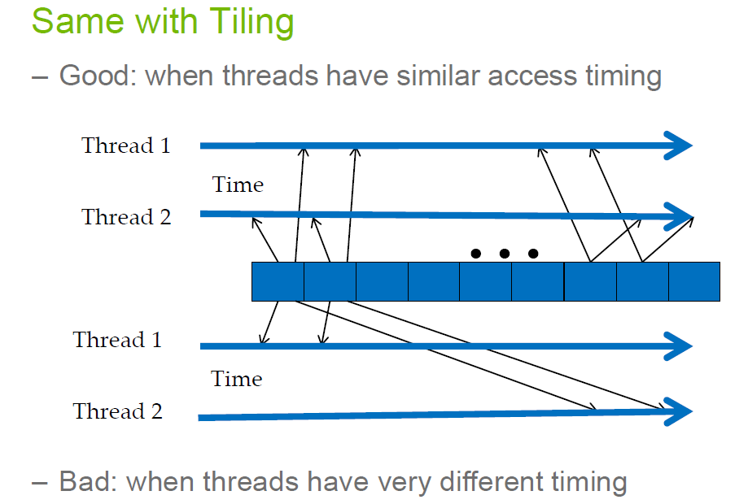

Slide 37
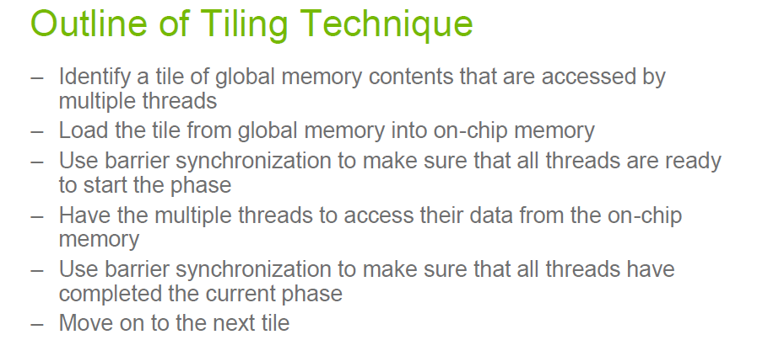

Slide 38
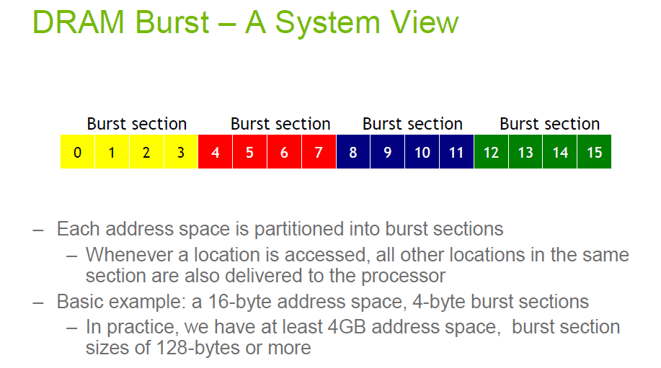

Slide 39
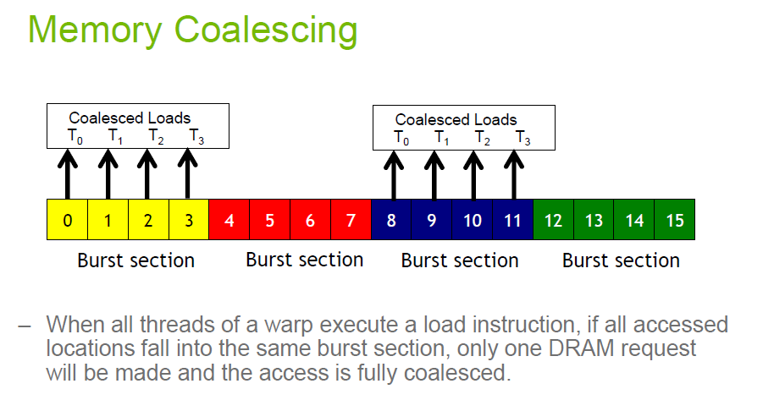

Slide 40
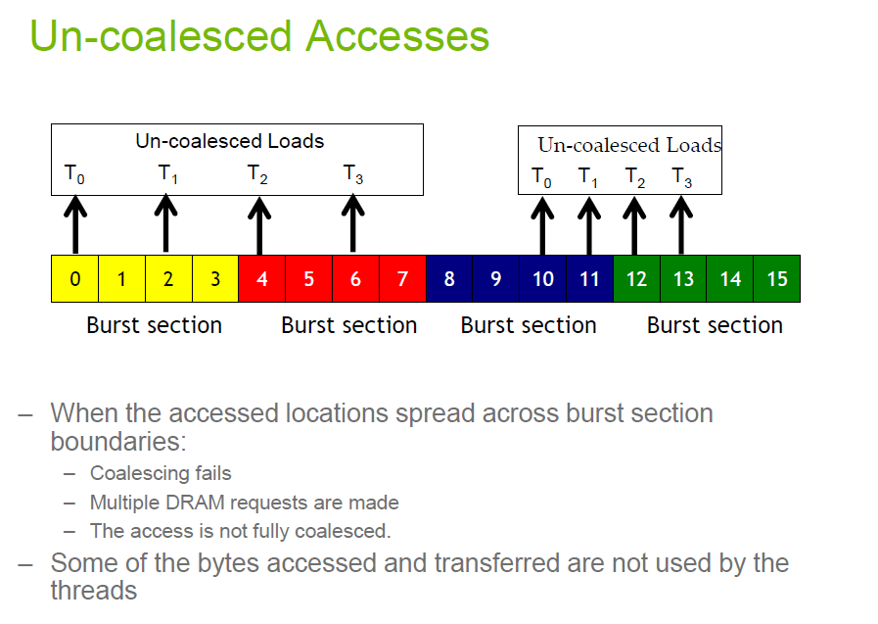

Slide 41
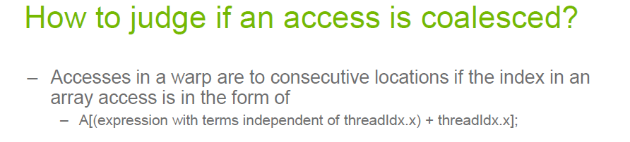

Slide 42
ATOMICS

Slide 43
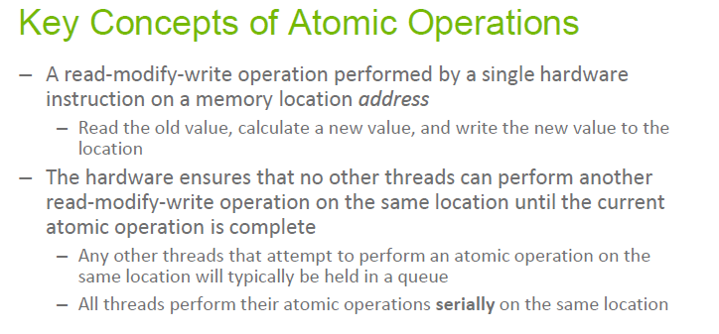

Slide 44
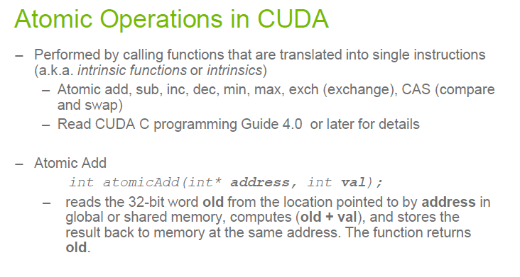

Slide 45
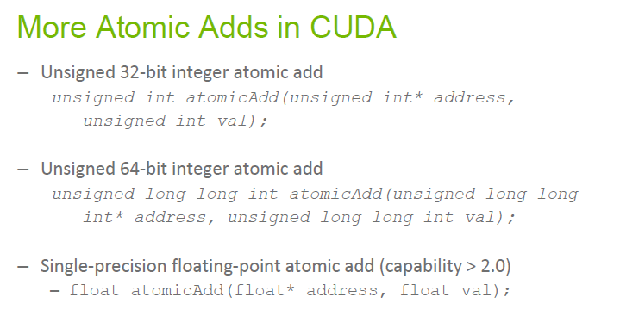

Slide 46
Thank you

